Slide 1







FITCHAIN FITNESS REVOLUTIONISED

Slide 2
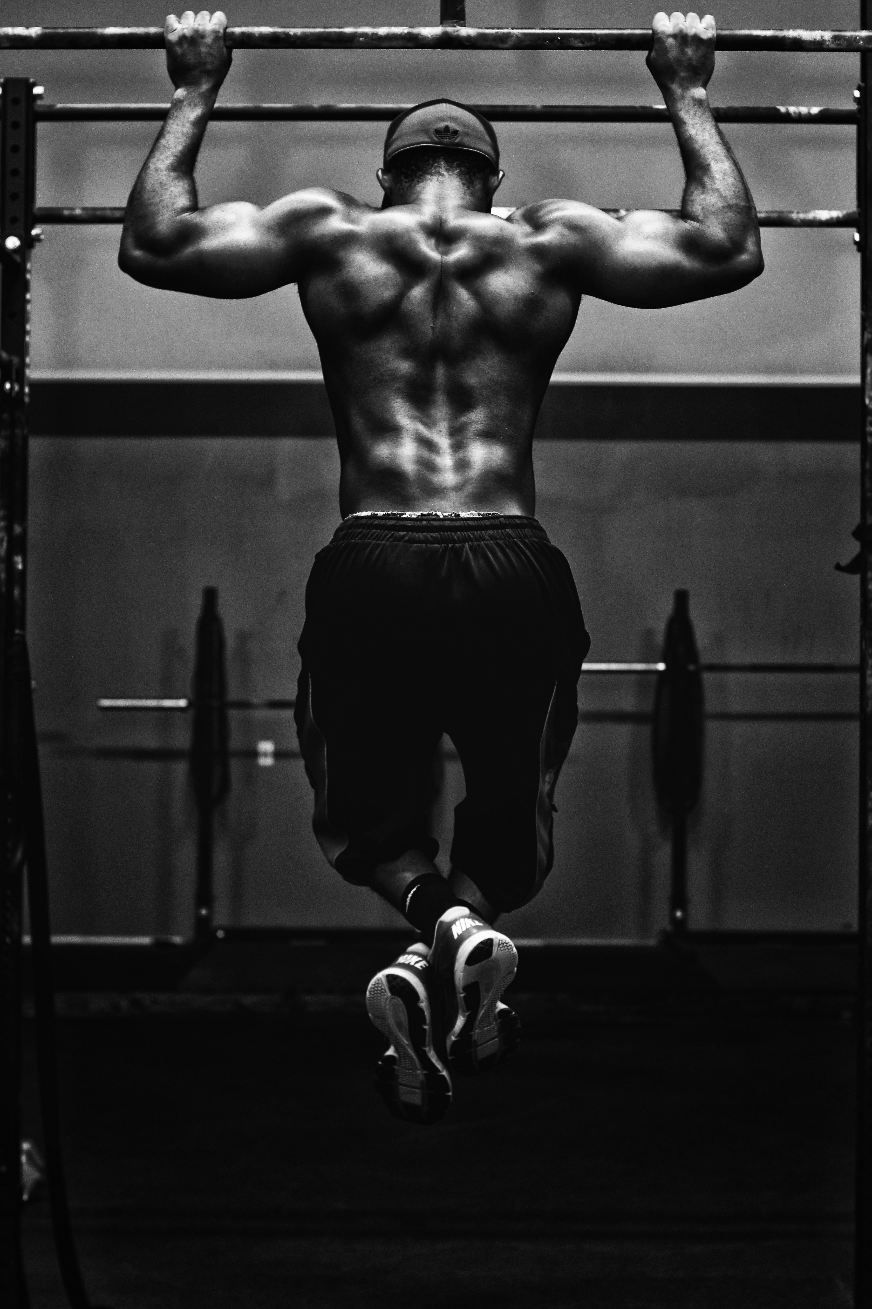
EARN FITCOINS BY COMPLETING WORKOUTS AND DAILY CHALLENGES

Slide 3

WHY FITCHAIN???
Tokenization and Incentives
Decentralized Marketplace
01
02
Data Security and Privacy
Community Engagement
03
04

Slide 4
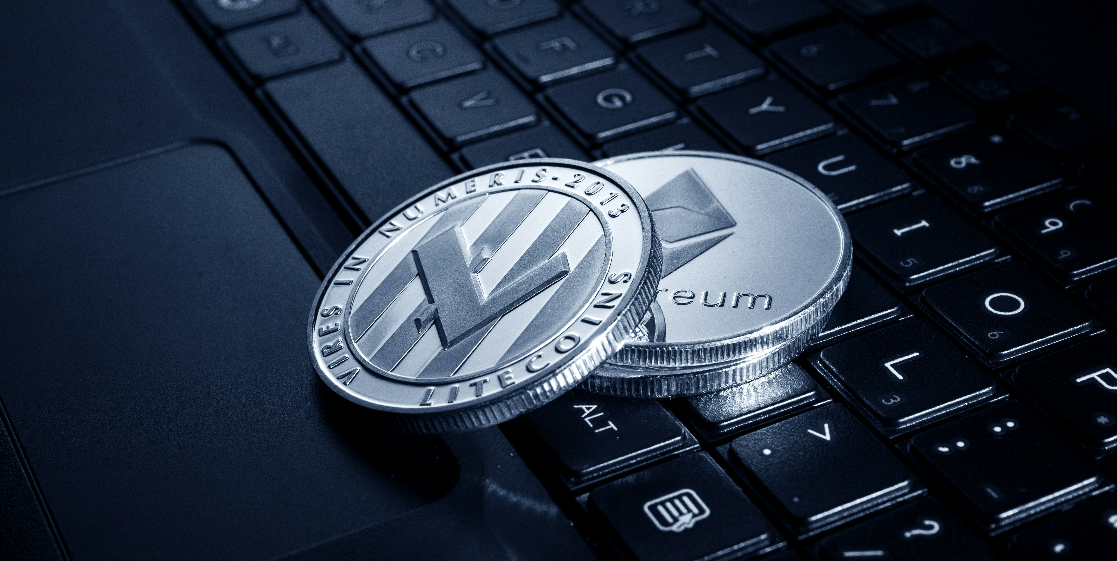

REDEEM FITCOINS AS COUPONS OR TRANSFER IT TO YOUR WALLET
01

Slide 5

Tokenization and Incentives
FitChain introduces its native cryptocurrency called “FitCoin”. Users earn FitCoins by completing workouts, achieving fitness milestones, and participating in challenges.

Slide 6
SMART CONTRACTS
Smart contracts are used to automate reward distribution. For instance, when a user completes a challenge or achieves a specific fitness goal, the smart contract automatically transfers FitCoins to their wallet based on predefined criteria.

Slide 7
WHAT MAKES FITCHAIN DIFFERENT
01
02
03
Community Engagement
Gamification
Transparency
FitChain incorporates gamification elements to make fitness more engaging and rewarding
The decentralized nature of blockchain technology ensures transparency and accountability in all aspects of the platform
The decentralized nature of blockchain technology ensures transparency and accountability in all aspects of the platform

Slide 8
WHAT MAKES FITCHAIN DIFFERENT
Decentralized Marketplace
Data Security and Privacy
Integration with Wearable Devices
buy and sell fitness-related products and services using FitCoins
utilizes blockchain technology to securely store user data, fitness metrics, and payment information
FitChain seamlessly integrates with wearable devices and trackers, allowing users to sync their activity data with the app

Slide 9
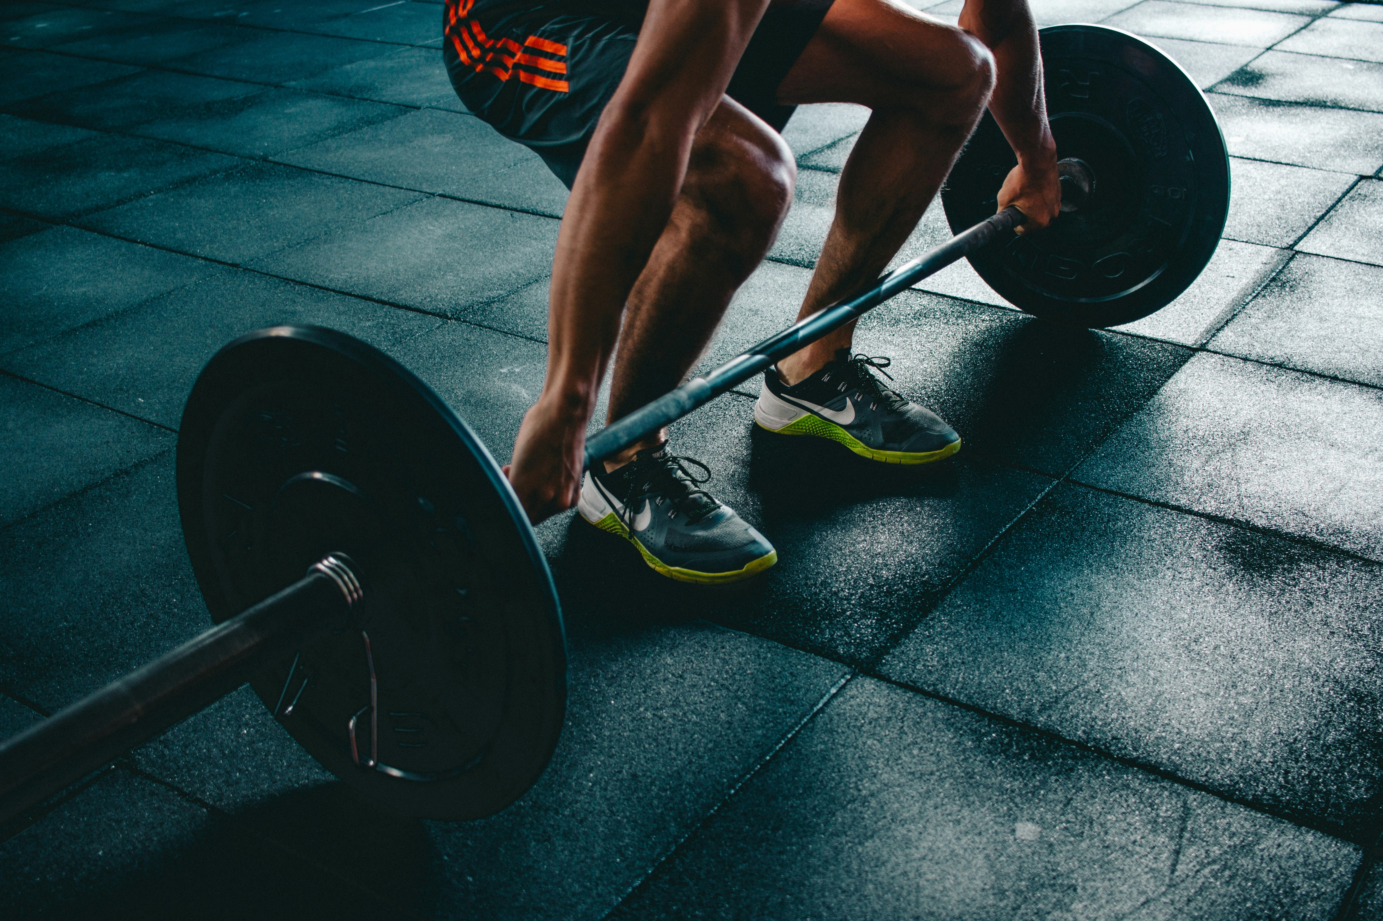


Community Engagement
FitChain fosters a vibrant community of fitness enthusiasts through social networking features, group challenges, and peer-to-peer interactions. Users can connect with each other, share workout routines, and support one another in achieving their fitness goals.

Slide 10
TRANSPERENCY
The decentralized nature of blockchain technology ensures transparency and accountability in all aspects of the platform. Users can verify the integrity of their fitness data, track the distribution of rewards, and confirm the authenticity of products and services available in the marketplace.

Slide 11
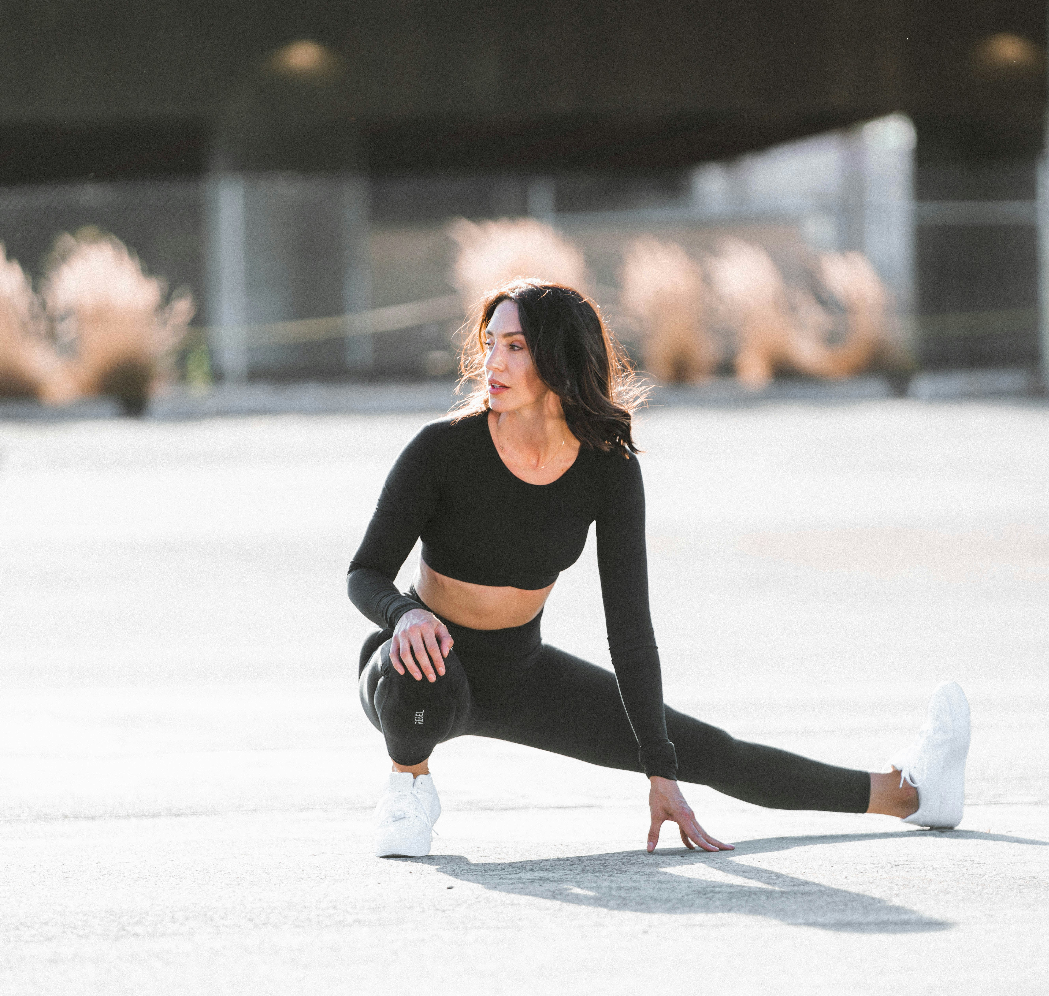
Integration with Wearable Devices
FitChain seamlessly integrates with popular wearable devices and fitness trackers, allowing users to sync their activity data with the app. This data is securely transmitted to the blockchain, ensuring accuracy and privacy.

Slide 12
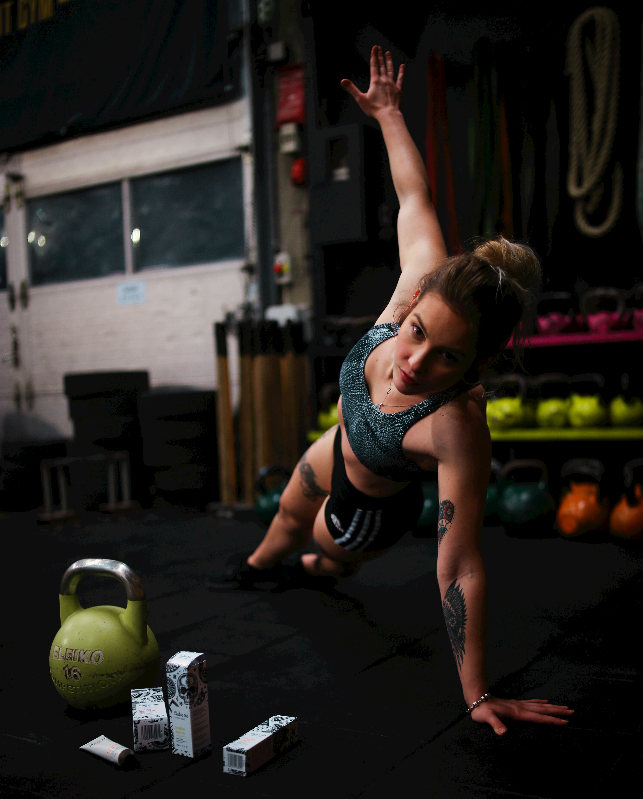
THANKYOU
TEAM MEMBERS
SAHIL PAHAPALE
SUDHISH REDDY
GAURAV PRASAD
AMAN SINGH

